Slide 1

Geometric Algebra in F#
Andrew J. Willshire

Slide 2
About Me
I am primarily an engineer / analyst (studied electrical engineering)
And then an applied mathematician (to a small extent within certain fields)
And then a programmer (for certain applications)
And then a physicist (I’m really, really not a physicist)
The way I have chosen to program this implementation reflects this
As does my ability to answer any particular questions
The implementation is designed for (my) understanding rather than performance

Slide 3
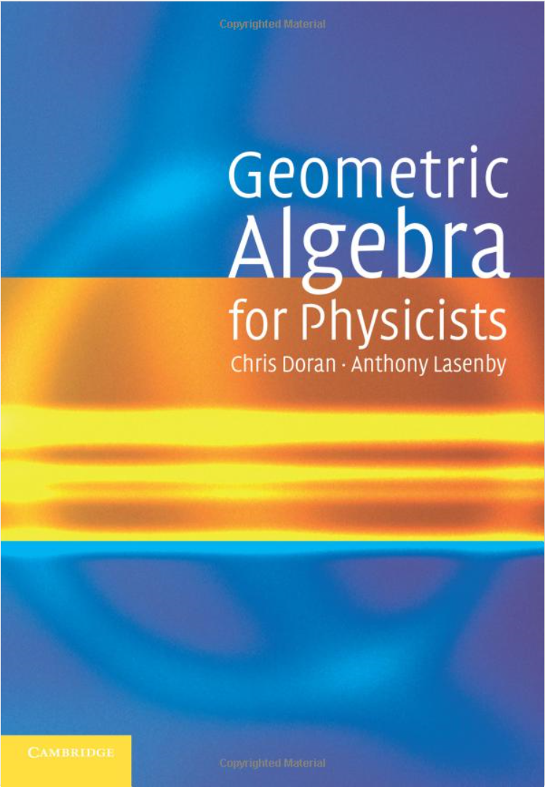
About this talk
Inspired by Chris Doran, a colleague from some years back who literally wrote the book on Geometric Algebra
And who spun out a computer graphics company from Cambridge University based on GA (Geomerics), which was subsequently sold to ARM
And who presented a talk at the Haskell eXchange 2017 on Geometric Algebra in Haskell https://skillsmatter.com/skillscasts/10772-geometric-algebra-in-haskell
So, in an effort to learn more about both GA and F#, I decided to do this talk
All mistakes are mine!

Slide 4
What is Geometric Algebra?
A mathematical framework which can unify different mathematical domains
An alternative to Hamilton’s quaternions and Heaviside’s vector analysis
Sometimes referred to as Clifford Algebra
Can result in simplified formulas and more intuitive results
David Hestenes and Chris Doran have advocated GA as the preferred mathematical framework for physics

Slide 5
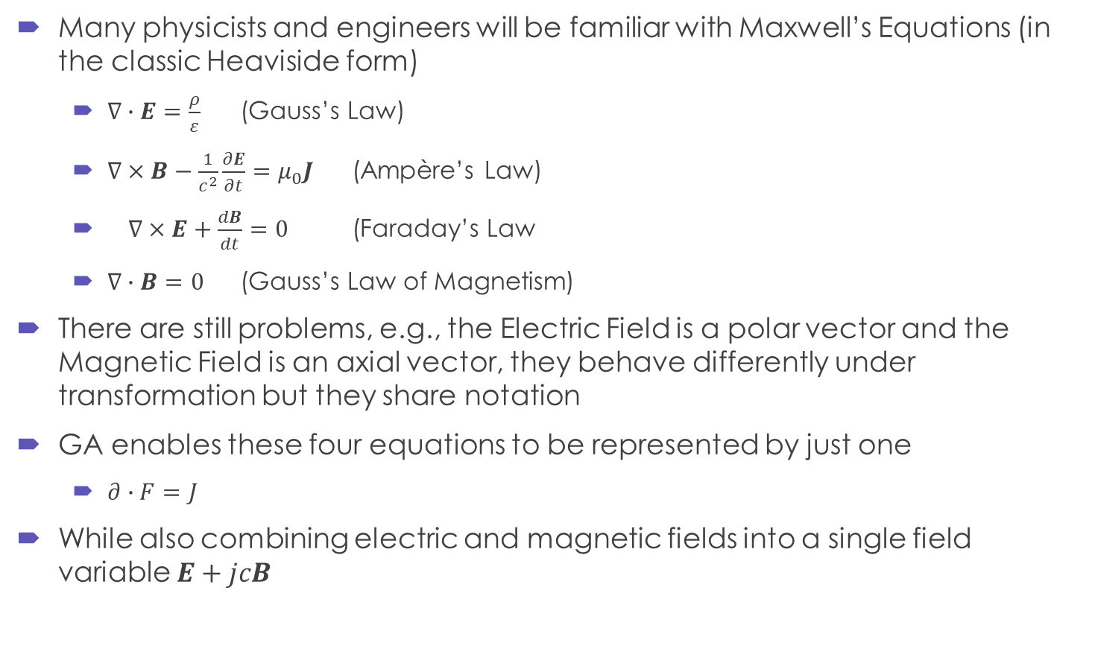
One interesting result…
Many physicists and engineers will be familiar with Maxwell’s Equations (in the classic Heaviside form)
$∇∙E=\frac{ρ}{ε}$ (Gauss’s Law)
$∇×B−\frac{1}{c^{2}}\frac{∂E}{∂t}=μ_{0}J$ (Ampère’s Law)
$∇×E+\frac{dB}{dt}=0$ (Faraday’s Law
$∇∙B=0$ (Gauss’s Law of Magnetism)
There are still problems, e.g., the Electric Field is a polar vector and the Magnetic Field is an axial vector, they behave differently under transformation but they share notation
GA enables these four equations to be represented by just one
$∂∙F=J$
While also combining electric and magnetic fields into a single field variable $E+jcB$
Geometric Algebra for Electrical and Electronic Engineers, Chappell et al

Slide 6
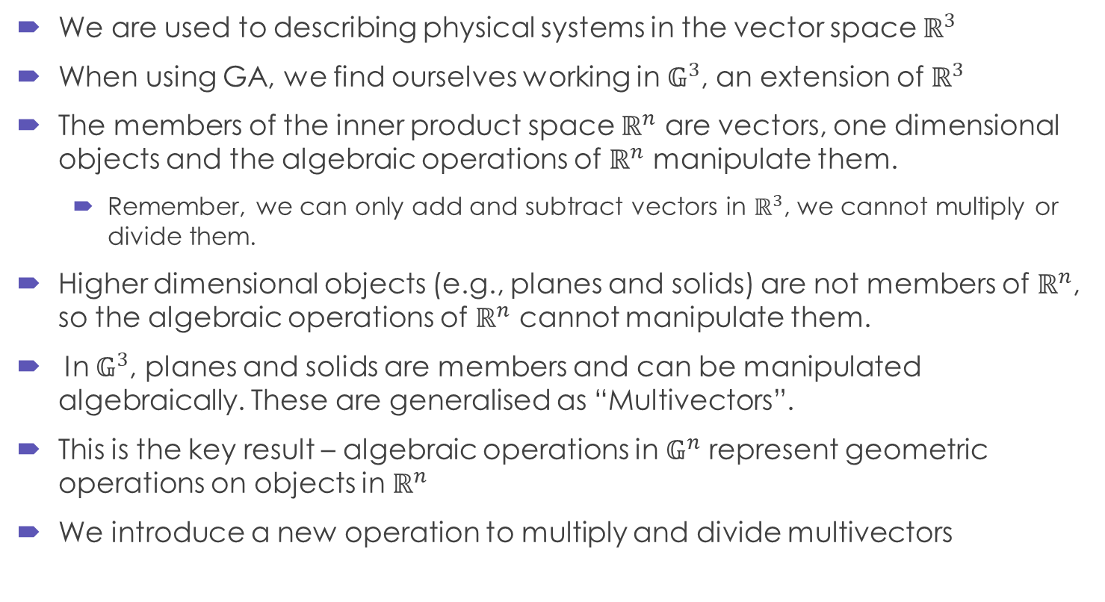
We’re not in Kansas any more…
We are used to describing physical systems in the vector space $ℝ^{3}$
When using GA, we find ourselves working in $𝔾^{3}$, an extension of $ℝ^{3}$
The members of the inner product space $ℝ^{n}$ are vectors, one dimensional objects and the algebraic operations of $ℝ^{n}$ manipulate them.
Remember, we can only add and subtract vectors in $ℝ^{3}$, we cannot multiply or divide them.
Higher dimensional objects (e.g., planes and solids) are not members of $ℝ^{n}$, so the algebraic operations of $ℝ^{n}$ cannot manipulate them.
In $𝔾^{3}$, planes and solids are members and can be manipulated algebraically. These are generalised as “Multivectors”.
This is the key result – algebraic operations in $𝔾^{n}$ represent geometric operations on objects in $ℝ^{n}$
We introduce a new operation to multiply and divide multivectors
Linear and Geometric Algebra, Alan Macdonald

Slide 7
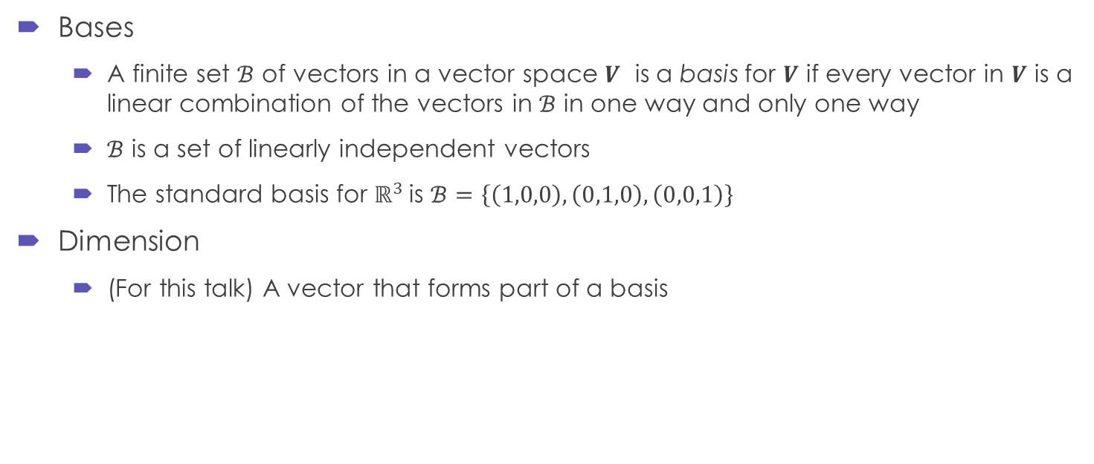
Bases and Dimensions
Bases
A finite set $ℬ$ of vectors in a vector space $V$ is a basis for $V$ if every vector in $V$ is a linear combination of the vectors in $ℬ$ in one way and only one way
$ℬ$ is a set of linearly independent vectors
The standard basis for $ℝ^{3}$is $ℬ=\left\{\left(1,0,0\right),\left(0,1,0\right),\left(0,0,1\right)\right\}$
Dimension
(For this talk) A vector that forms part of a basis

Slide 8
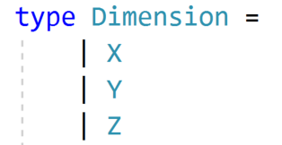
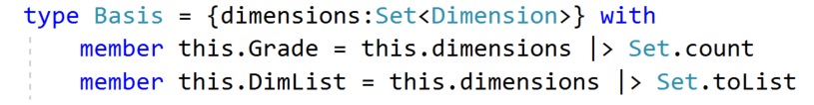
Bases and Dimensions in F#
We require three orthonormal vectors (mutual right angles) to define our space
I’m going to choose X, Y and Z
Physicists often use e1, e2, e3
I’m going to declare Dimensions as an F# union type
Similar to, but distinct from, enums
I’m also going to define a “Basis” as a Set of Dimensions
(With some helper functions)

Slide 9
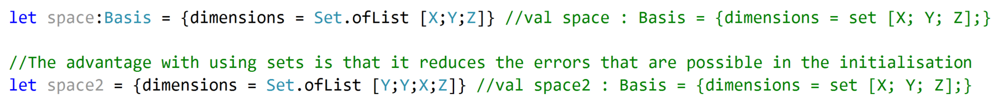
Let’s talk about Sets, baby
“A set in F# is a data structure that acts as a collection of items without preserving the order in which items are inserted. Sets do not allow duplicate entries to be inserted into the collection.”
In conjunction with the union type definition for dimensions, it arranges them in the correct order
When working with Vectors, etc., knowing that your dimensions must be in the right order is useful!
https://www.tutorialspoint.com/fsharp/fsharp_sets.htm

Slide 10
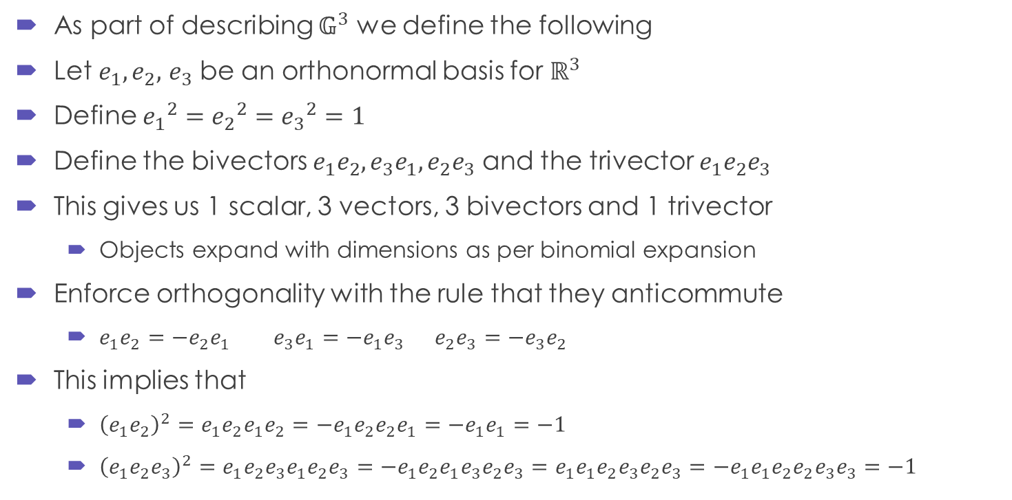

Objects in $𝔾^{3}$
As part of describing $𝔾^{3}$ we define the following
Let $e_{1},e_{2},$ $e_{3}$ be an orthonormal basis for $ℝ^{3}$
Define ${e_{1}}^{2}={e_{2}}^{2}={e_{3}}^{2}=1$
Define the bivectors $e_{1}e_{2},e_{3}e_{1},e_{2}e_{3}$ and the trivector $e_{1}e_{2}e_{3}$
This gives us 1 scalar, 3 vectors, 3 bivectors and 1 trivector
Objects expand with dimensions as per binomial expansion
Enforce orthogonality with the rule that they anticommute
$e_{1}e_{2}=−e_{2}e_{1}$ $e_{3}e_{1}=−e_{1}e_{3}$ $e_{2}e_{3}=−e_{3}e_{2}$
This implies that
${\left(e_{1}e_{2}\right)}^{2}=e_{1}e_{2}e_{1}e_{2}=−e_{1}e_{2}e_{2}e_{1}=−e_{1}e_{1}=−1$
${\left(e_{1}e_{2}e_{3}\right)}^{2}=e_{1}e_{2}e_{3}e_{1}e_{2}e_{3}=−e_{1}e_{2}e_{1}e_{3}e_{2}e_{3}=e_{1}e_{1}e_{2}e_{3}e_{2}e_{3}=−e_{1}e_{1}e_{2}e_{2}e_{3}e_{3}=−1$

Slide 11
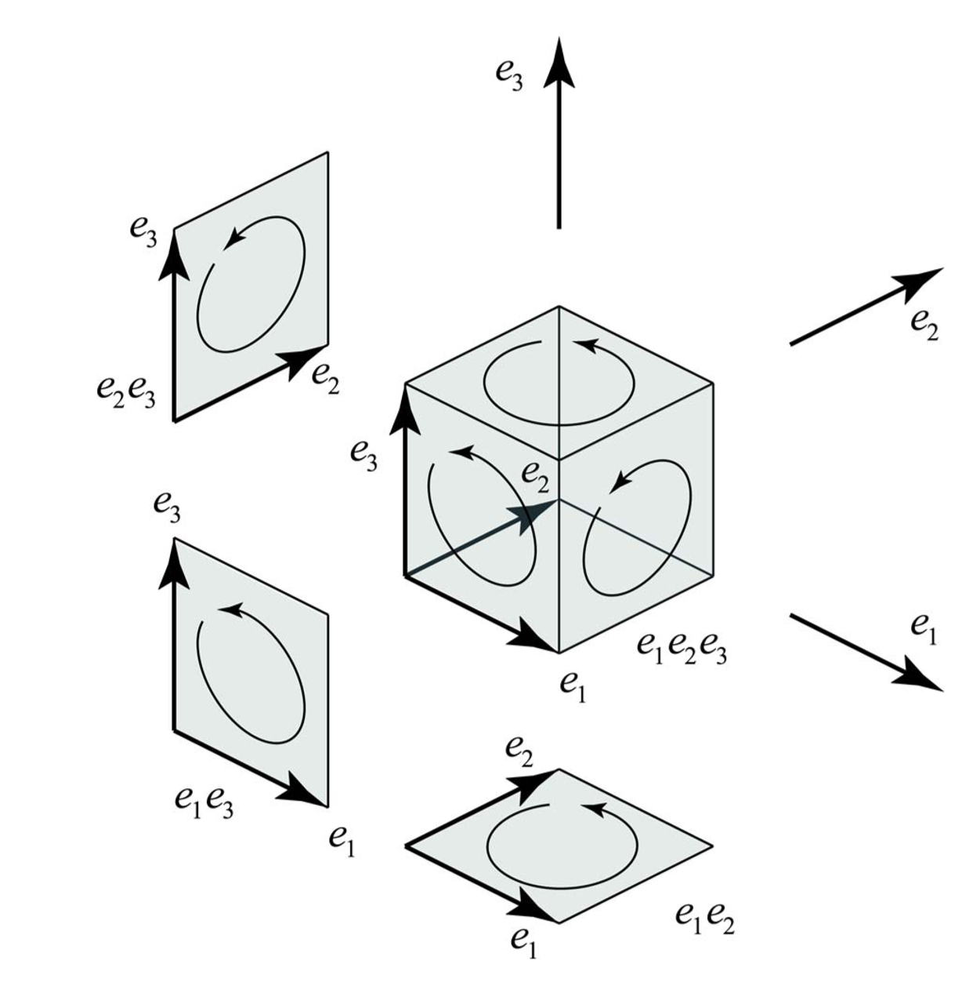

Visualising Members of $𝔾^{3}$
Geometric Algebra for Electrical and Electronic Engineers, Chappell et al

Slide 12

Calculations with Bivectors and Trivectors
Enforce orthogonality with the rule that they anticommute
$e_{1}e_{2}=−e_{2}e_{1}$ $e_{3}e_{1}=−e_{1}e_{3}$ $e_{2}e_{3}=−e_{3}e_{2}$
This implies that
${\left(e_{1}e_{2}\right)}^{2}=e_{1}e_{2}e_{1}e_{2}=−e_{1}e_{2}e_{2}e_{1}=−e_{1}e_{1}=−1$
${\left(e_{1}e_{2}e_{3}\right)}^{2}=e_{1}e_{2}e_{3}e_{1}e_{2}e_{3}=−e_{1}e_{2}e_{1}e_{3}e_{2}e_{3}=e_{1}e_{1}e_{2}e_{3}e_{2}e_{3}=−e_{1}e_{1}e_{2}e_{2}e_{3}e_{3}=−1$

Slide 13
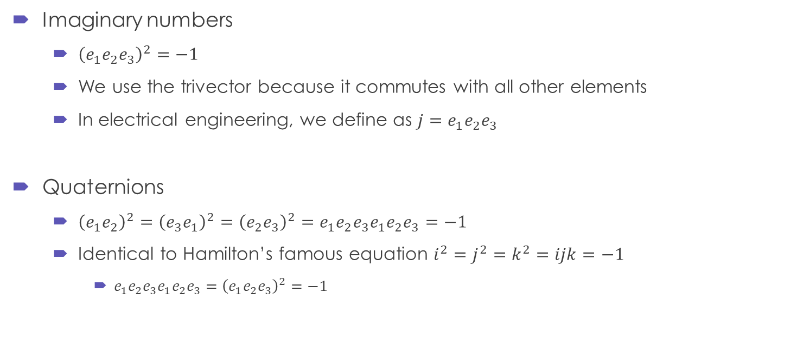
Incidentally, we just discovered
Imaginary numbers
${\left(e_{1}e_{2}e_{3}\right)}^{2}=−1$
We use the trivector because it commutes with all other elements
In electrical engineering, we define as $j=e_{1}e_{2}e_{3}$
Quaternions
${\left(e_{1}e_{2}\right)}^{2}={\left(e_{3}e_{1}\right)}^{2}={\left(e_{2}e_{3}\right)}^{2}=e_{1}e_{2}e_{3}e_{1}e_{2}e_{3}=−1$
Identical to Hamilton’s famous equation $i^{2}=j^{2}=k^{2}=ijk=−1$
$e_{1}e_{2}e_{3}e_{1}e_{2}e_{3}={\left(e_{1}e_{2}e_{3}\right)}^{2}=−1$

Slide 14
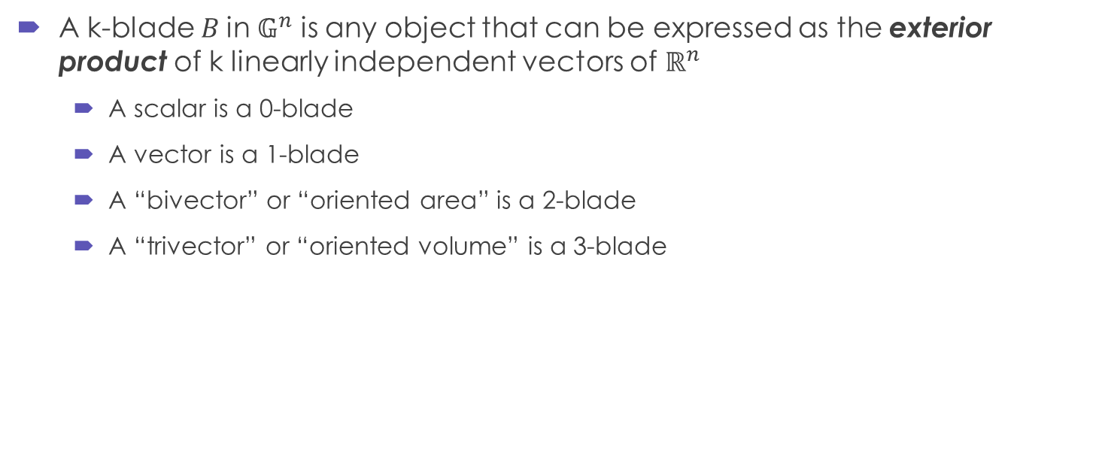
Blades
A k-blade $B$in $𝔾^{n}$ is any object that can be expressed as the exterior product of k linearly independent vectors of $ℝ^{n}$
A scalar is a 0-blade
A vector is a 1-blade
A “bivector” or “oriented area” is a 2-blade
A “trivector” or “oriented volume” is a 3-blade

Slide 15
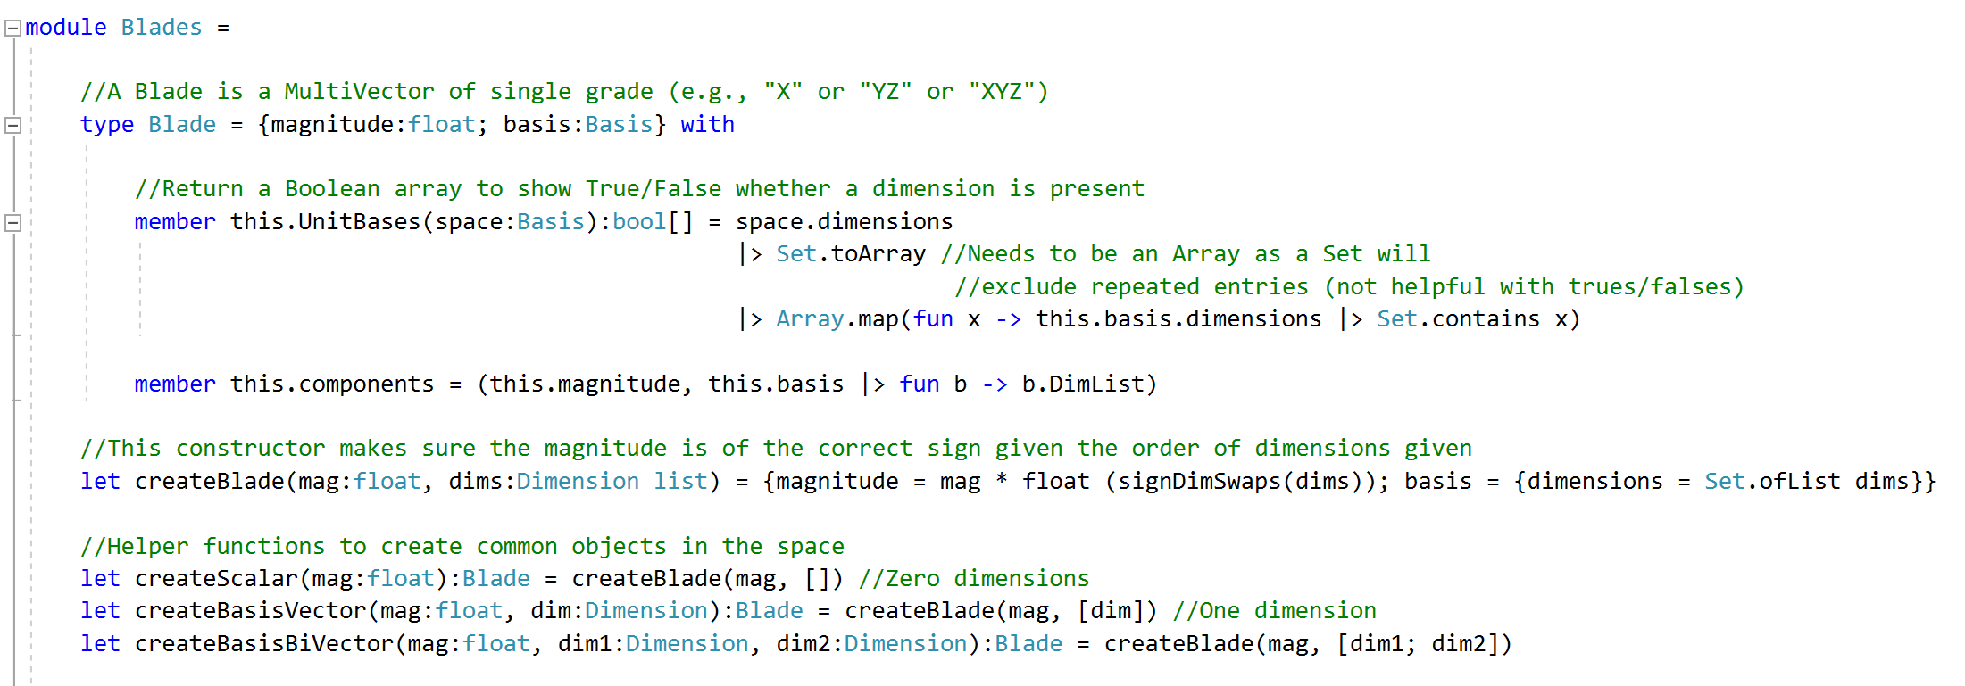
Blades in F#
Let’s define a “Blade” type as a magnitude on a particular Basis

Slide 16
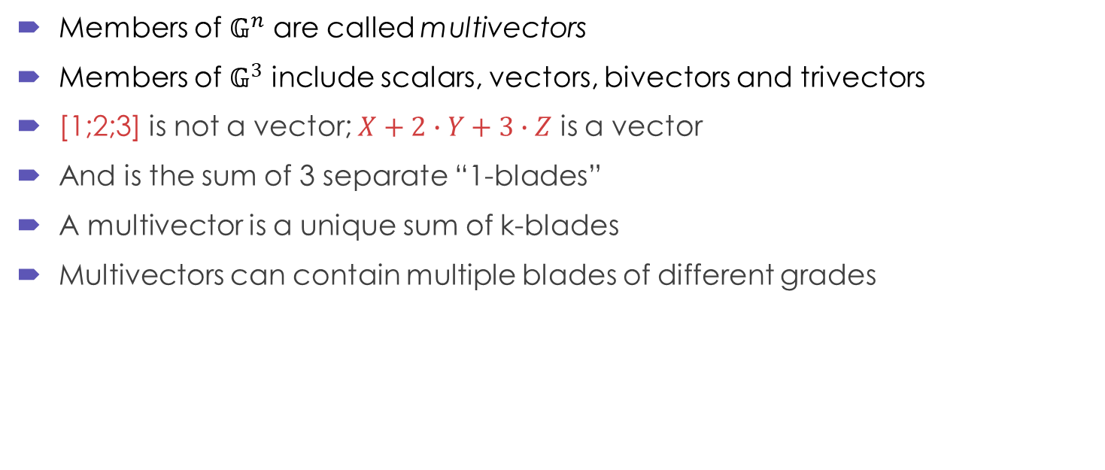
Multivectors
Members of $𝔾^{n}$ are called multivectors
Members of $𝔾^{3}$ include scalars, vectors, bivectors and trivectors
[1;2;3] is not a vector; $X+2∙Y+3∙Z$ is a vector
And is the sum of 3 separate “1-blades”
A multivector is a unique sum of k-blades
Multivectors can contain multiple blades of different grades

Slide 17
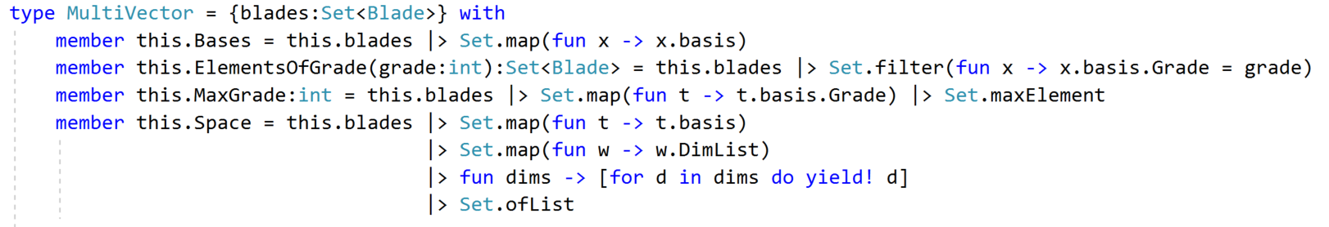
Multivectors in F#
We can define a MultiVector as a Set of Blades
Any collection type would probably do
Ideally, we don’t want repeated elements but we don’t want to lose elements accidentally

Slide 18

Multiplication
We cannot multiply vectors in $ℝ^{n}$
We often encounter the dot product and the cross product
The outer product may be unfamiliar
In $𝔾^{n}$ we define multiplication with the geometric product

Slide 19

Inner (Dot) Product
The inner product is a scalar quantity produced from two vectors
Usually referred to as the dot product in physics
$u∙v=\sum_{i=1}^{n}{u_{i}v_{i}}=\left\|u\right\|\left\|v\right\|\cos{θ}$
Note that$u_{i}e_{i}v_{i}e_{i}=$ $u_{i}v_{i}{e_{1}}^{2}$ = $u_{i}v_{i}$

Slide 20
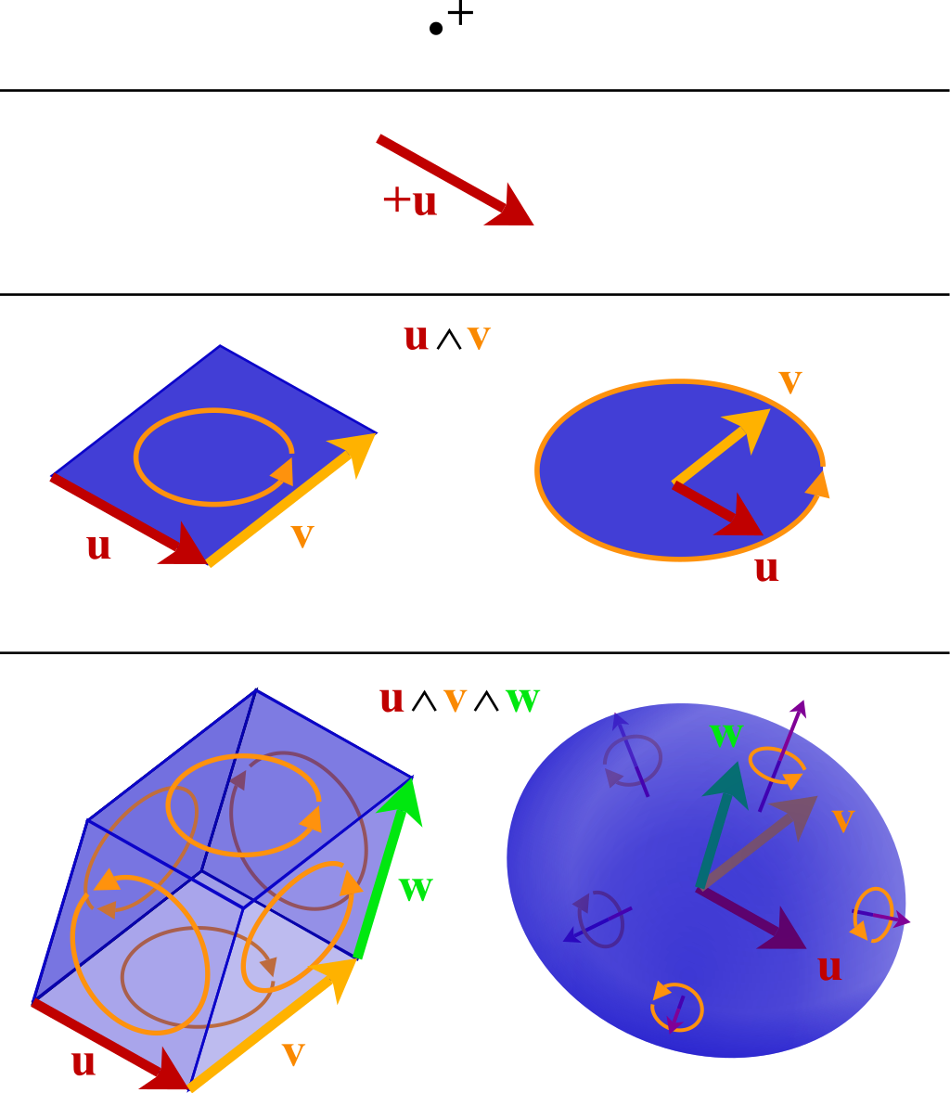
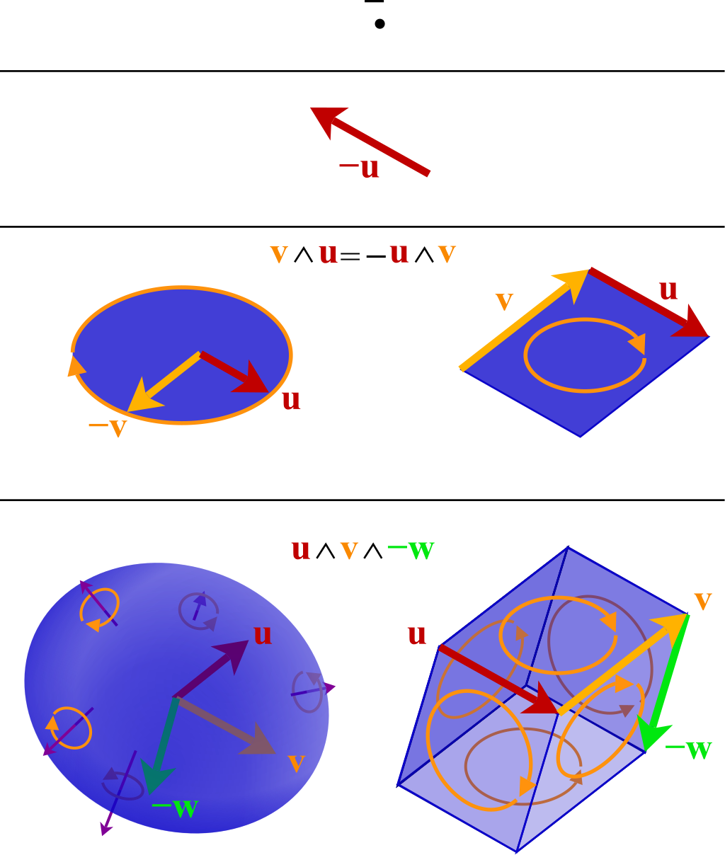
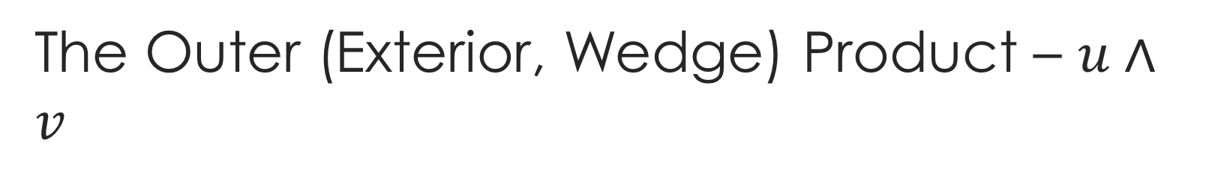
The Outer (Exterior, Wedge) Product – $u∧v$
The outer product in $ℜ^{3}$ is the area or volume bounded by vectors
https://en.wikipedia.org/wiki/Exterior_algebra

Slide 21
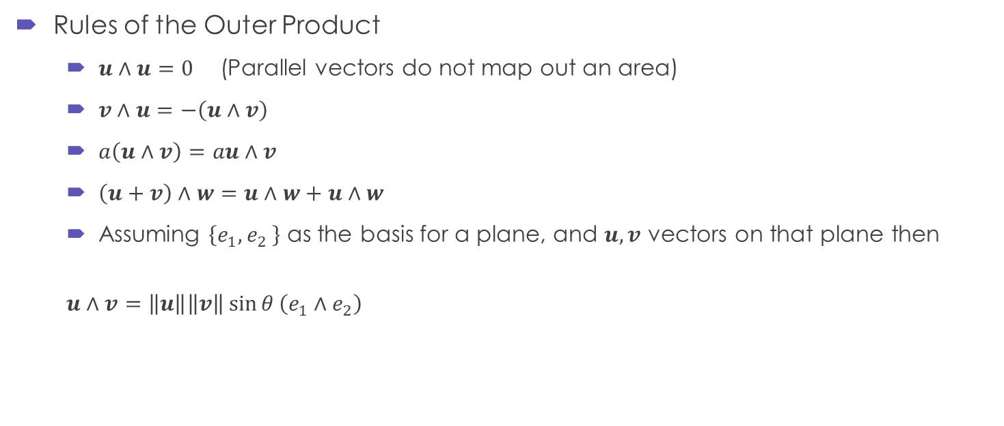
The Outer Product
Rules of the Outer Product
$u∧u=0$ (Parallel vectors do not map out an area)
$v∧u=−\left(u∧v\right)$
$a\left(u∧v\right)=au∧v$
$\left(u+v\right)∧w=u∧w+u∧w$
Assuming $\left\{e_{1}{,e}_{2}\right\}$ as the basis for a plane, and $u,v$ vectors on that plane then
$$u∧v=\left\|u\right\|\left\|v\right\|\sin{θ}\left(e_{1}∧e_{2}\right)$$

Slide 22
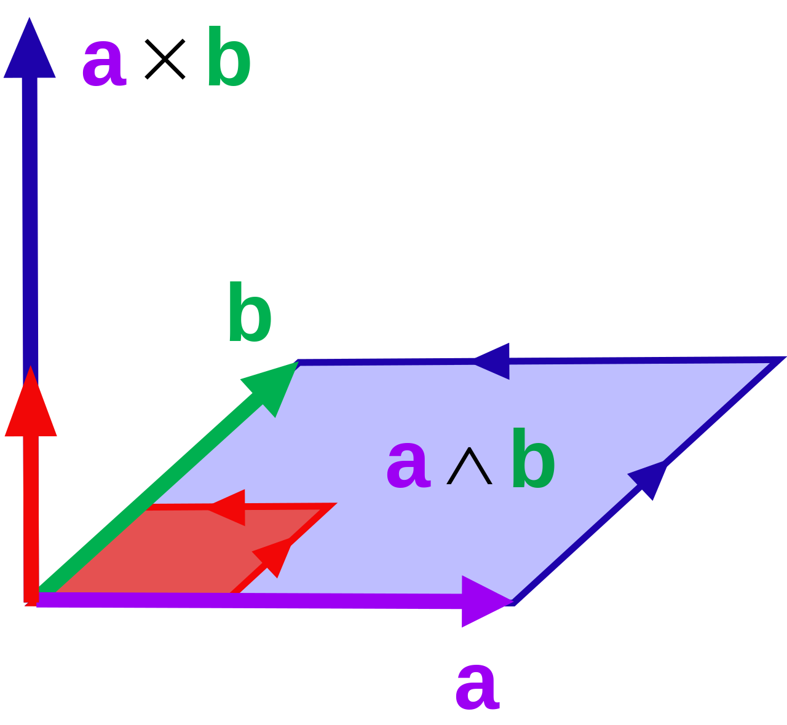
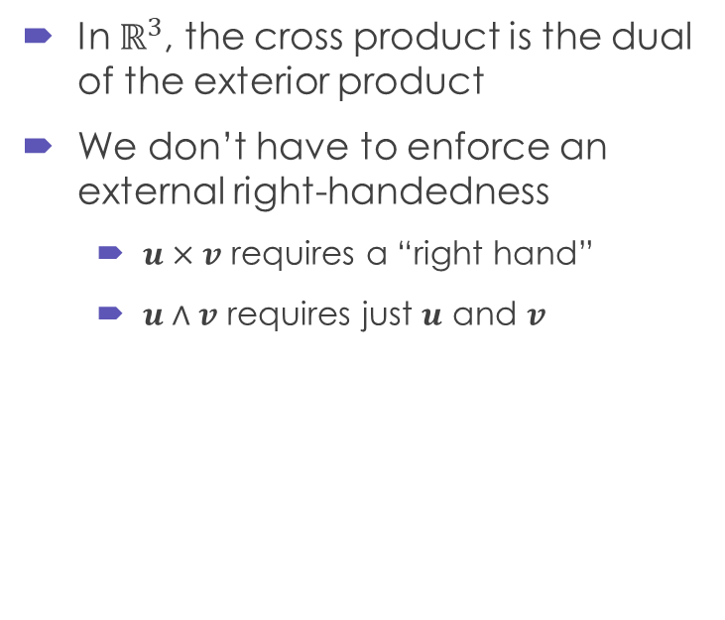
Relationship to the Cross Product
In $ℝ^{3}$, the cross product is the dual of the exterior product
We don’t have to enforce an external right-handedness
$u×v$ requires a “right hand”
$u∧v$ requires just $u$ and $v$
https://en.wikipedia.org/wiki/Exterior_algebra

Slide 23
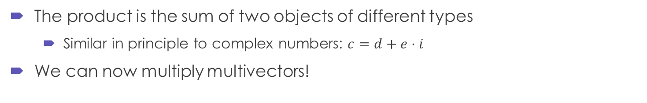

Geometric product
This is the fundamental identity of GA
Inner product (scalar)
Exterior product (bivector)
$$ab=a∙b+a∧b$$
The product is the sum of two objects of different types
Similar in principle to complex numbers: $c=d+e⋅i$
We can now multiply multivectors!

Slide 24
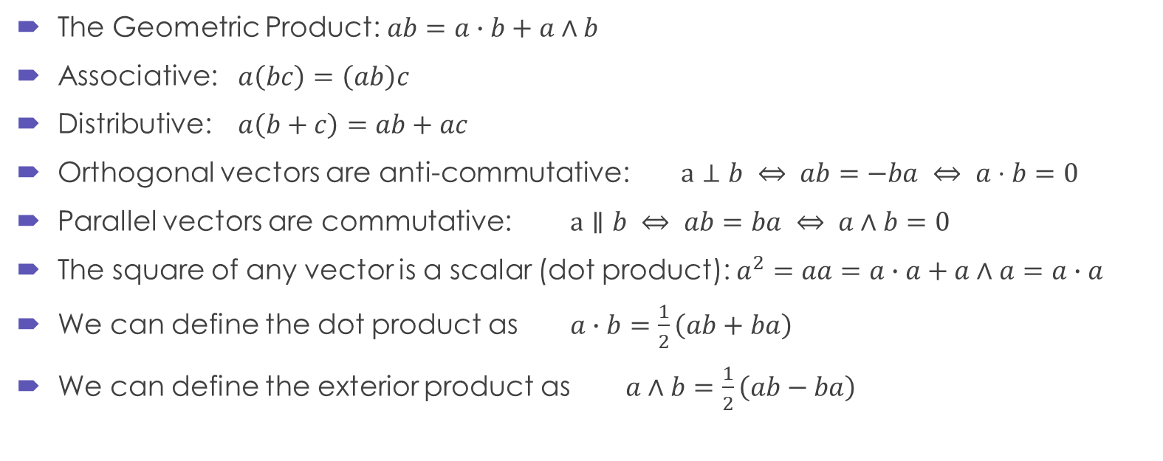
Rules of the Geometric Product
The Geometric Product: $ab=a∙b+a∧b$
Associative: $a\left(bc\right)=\left(ab\right)c$
Distributive: $a\left(b+c\right)=ab+ac$
Orthogonal vectors are anti-commutative: $a⊥b ⇔ ab=−ba ⇔ a⋅b=0$
Parallel vectors are commutative: $a∥b ⇔ ab=ba ⇔ a∧b=0$
The square of any vector is a scalar (dot product): $a^{2}=aa=a∙a+a∧a=a∙a$
We can define the dot product as $a∙b=\frac{1}{2}\left(ab+ba\right)$
We can define the exterior product as $a∧b=\frac{1}{2}\left(ab−ba\right)$

Slide 25
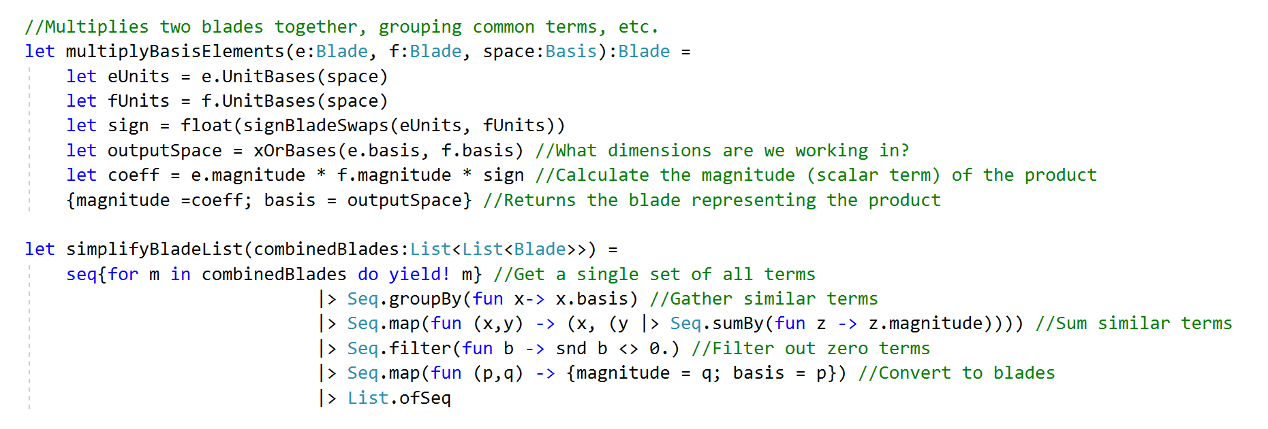
Calculating the Geometric Product in F# (1)
Multiplying blades together is the key operation
We also want to simplify the output of multiple operations

Slide 26
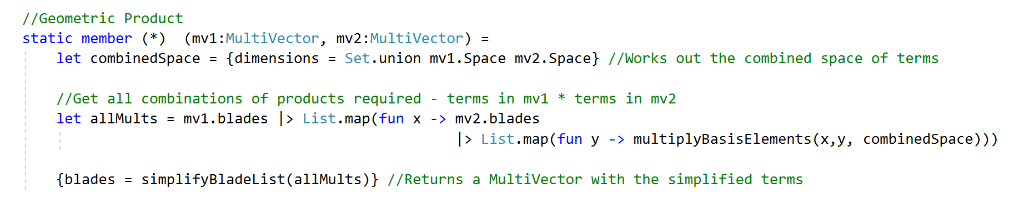
Calculating the Geometric Product in F# (2)
We can then add the multiplication operator to the MultiVector Type

Slide 27
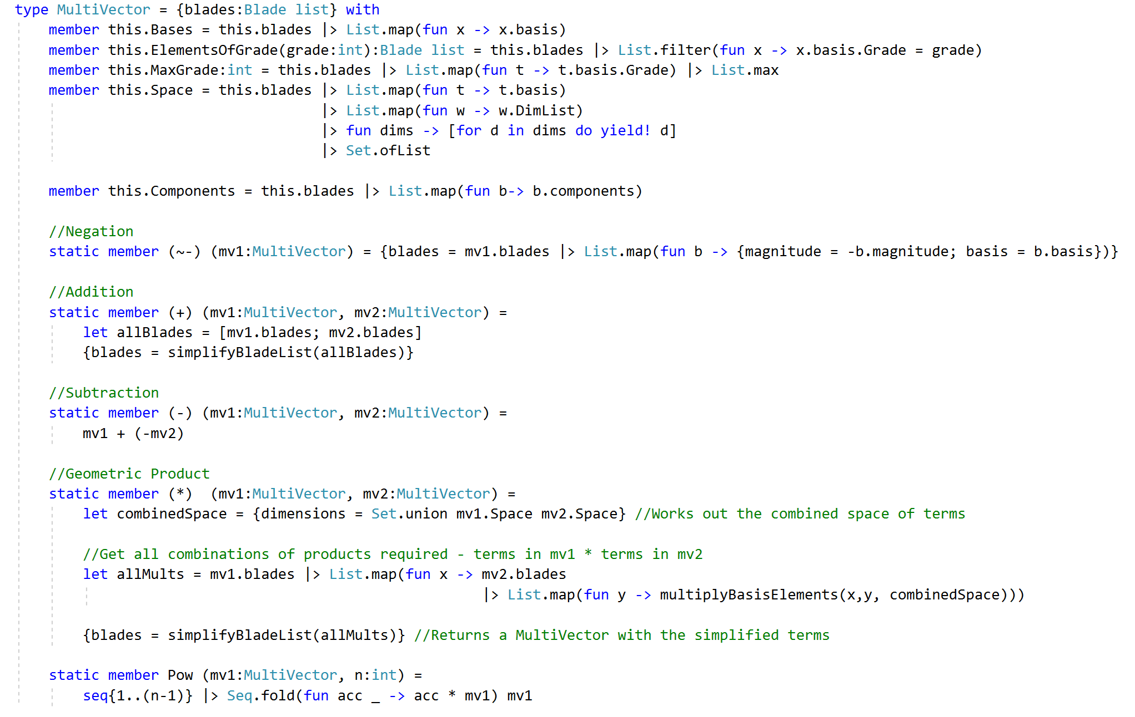
Other member functions of Multivectors

Slide 28
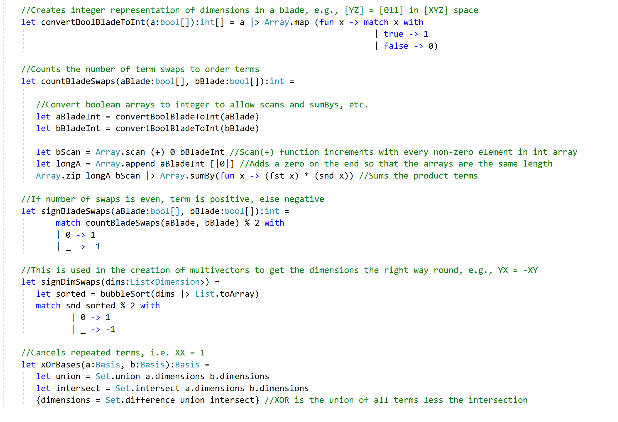
Other interesting bits…

Slide 29
Example 1
Simple Algebra

Slide 30
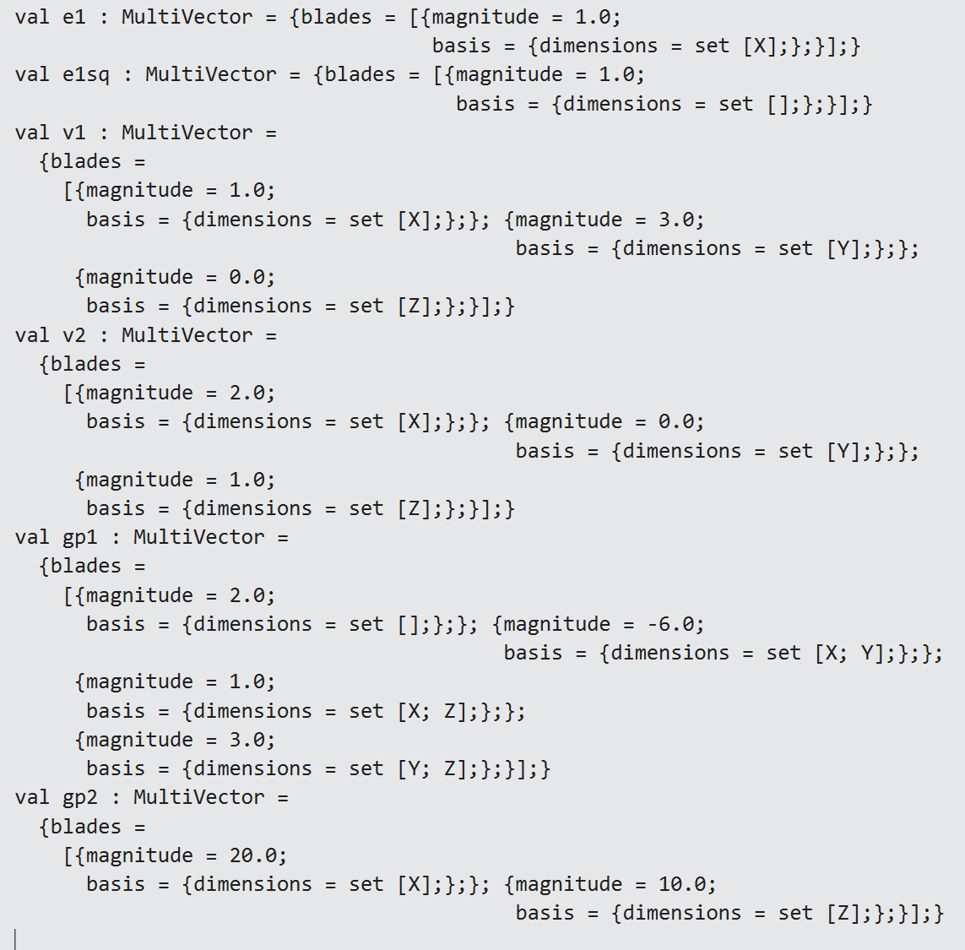
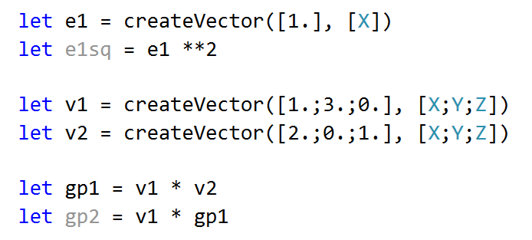
Examples (1)

Slide 31
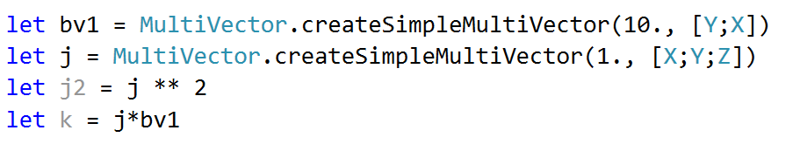
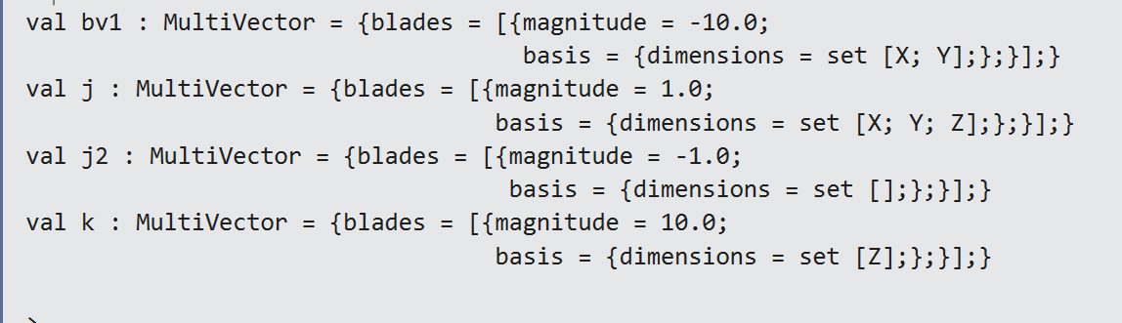
Examples (2)

Slide 32
Example 2
Calculating Torque

Slide 33









2D Example - Torque
How do we calculate the torque at the axis of rotation?
$$\vec{F}=900N$$
$$\vec{r}=0.8m$$
$$71°$$
$$x$$
$$τ=\vec{r}×\vec{F}$$
$$\vec{l}$$
$$\vec{l}=0.8∙\sin{71}°=0.76m$$
$$\vec{F}$$
$$y$$
The z-axis (and therefore the torque) goes “into the plane of the figure”

Slide 34
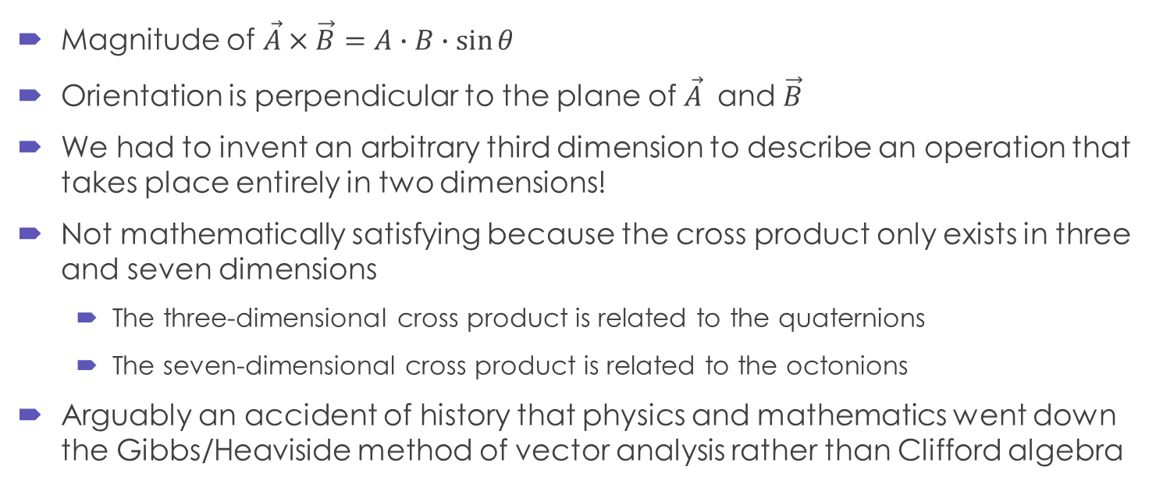
Cross Product
Magnitude of $\vec{A}×\vec{B}=A∙B∙\sin{θ}$
Orientation is perpendicular to the plane of $\vec{A}$ and $\vec{B}$
We had to invent an arbitrary third dimension to describe an operation that takes place entirely in two dimensions!
Not mathematically satisfying because the cross product only exists in three and seven dimensions
The three-dimensional cross product is related to the quaternions
The seven-dimensional cross product is related to the octonions
Arguably an accident of history that physics and mathematics went down the Gibbs/Heaviside method of vector analysis rather than Clifford algebra

Slide 35

2D Example - Torque
How do we calculate the torque at the axis of rotation?
$$\vec{F}=900N$$
$$\vec{r}=0.8m$$
$$71°$$
$$x$$
$$τ=\vec{r}×\vec{F}$$
$$\vec{l}$$
$$\vec{l}=0.8∙\sin{71}°=0.76m$$
$$\left|τ\right|=0.76∙900=684$$
$$\vec{F}$$
$$y$$
The z-axis (and therefore the torque) goes “into the plane of the figure”

Slide 36
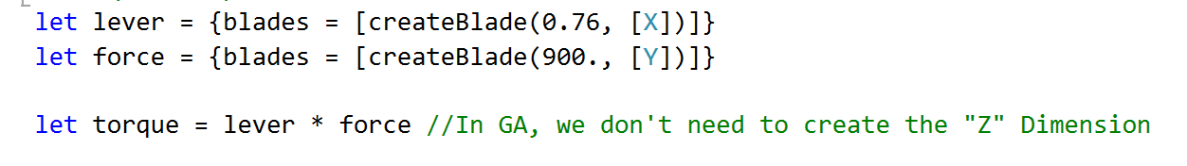
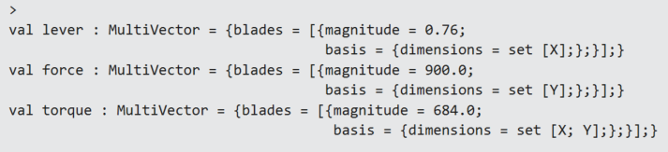
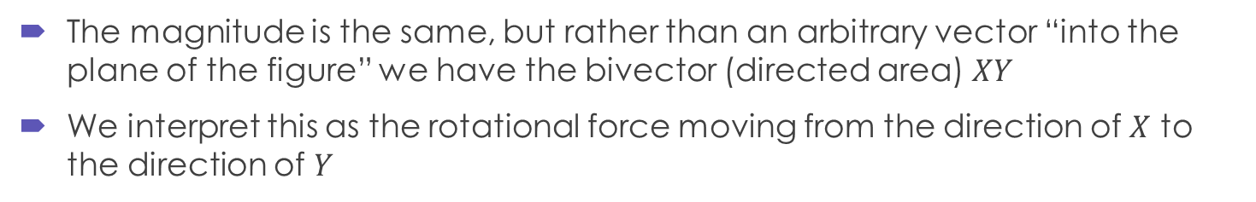
In GA…
The magnitude is the same, but rather than an arbitrary vector “into the plane of the figure” we have the bivector (directed area) $XY$
We interpret this as the rotational force moving from the direction of $X$ to the direction of $Y$

Slide 37


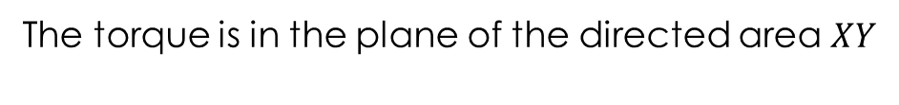
2D Example - Torque
How do we calculate the torque at the axis of rotation?
$$\vec{F}=900N$$
$$\vec{r}=0.8m$$
$$71°$$
$$x$$
$$τ=\vec{r}\vec{F}$$
$$\vec{l}$$
$$XY$$
$$\vec{F}$$
$$y$$
The torque is in the plane of the directed area $XY$

Slide 38
Example 3
Calculating Reflections and Rotations in 3D Space

Slide 39
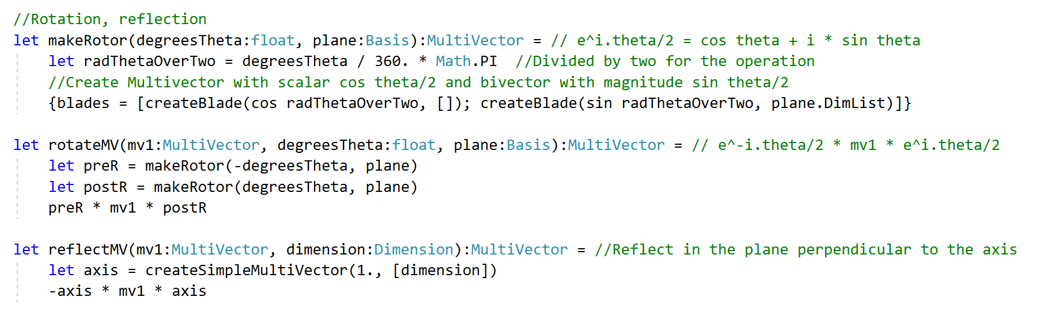
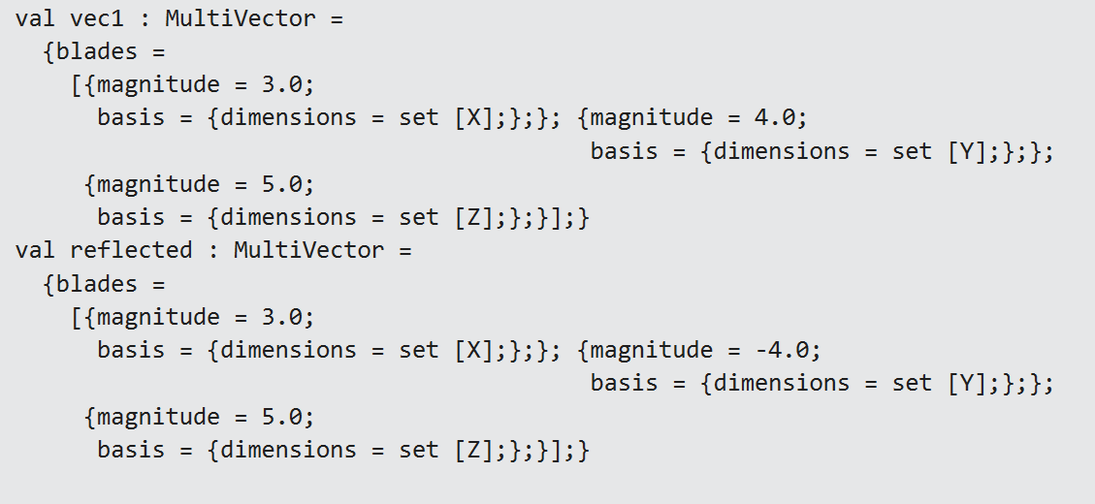
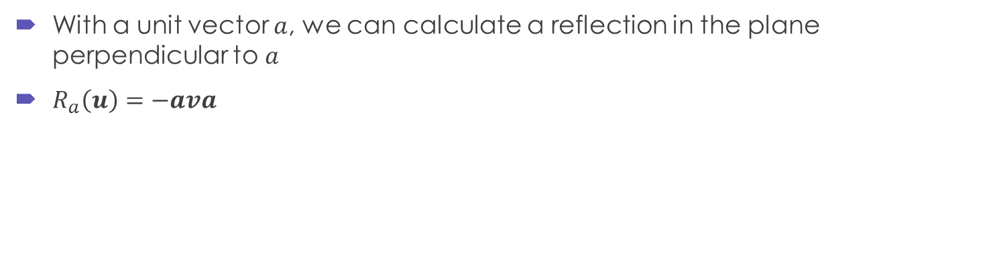
Reflection
With a unit vector $a$, we can calculate a reflection in the plane perpendicular to $a$
$R_{a}\left(u\right)=−ava$

Slide 40
Reflection Output

Slide 41
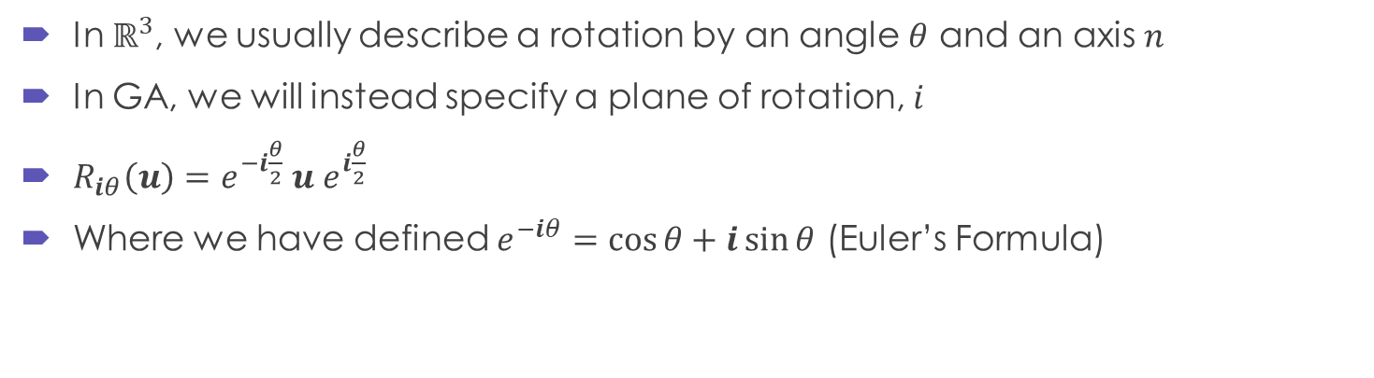
Rotation
In $ℝ^{3}$, we usually describe a rotation by an angle $θ$ and an axis $n$
In GA, we will instead specify a plane of rotation, $i$
$R_{iθ}\left(u\right)=e^{−i\frac{θ}{2}} u$ $e^{i\frac{θ}{2}}$
Where we have defined $e^{−iθ}=\cos{θ}+i\sin{θ}$ (Euler’s Formula)

Slide 42
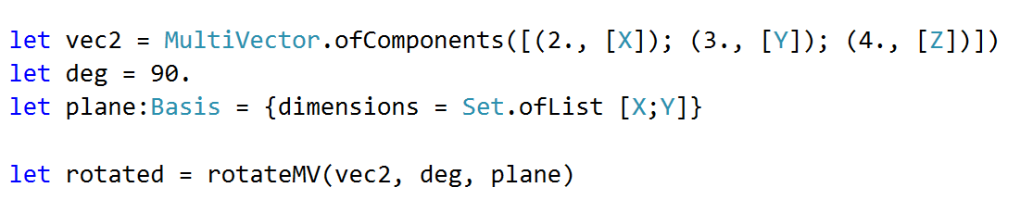
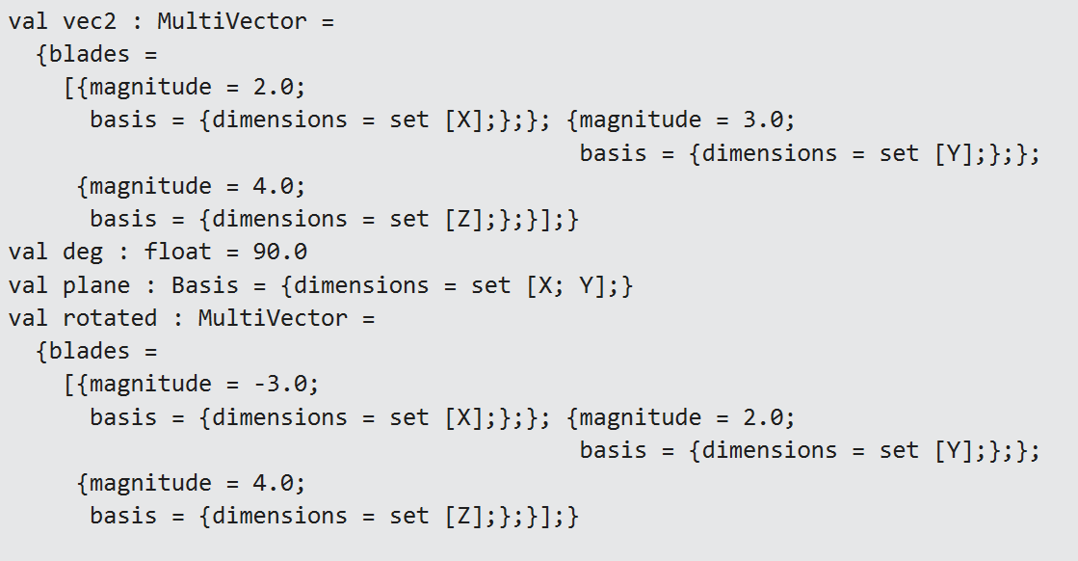
Rotation Output

Slide 43
Future Development
Needs more rigour in the mathematics and F#
Mistakes and misconceptions need to be addressed
Needs to be “more complete”, e.g., comparison functions
Possibly submit to MathNet.Numerics (?)
All offers of help gratefully received!

Slide 44
Resources
Geometric Algebra for Physicists, Chris Doran and Anthony Lasenby, Cambridge University Press, 2007
Linear and Geometric Algebra, Alan Macdonald, 2010
Geometric Algebra for Electrical and Electronic Engineers, Chappell et al, Proceedings of the IEEE, Vol 102, No 9, September 2014
http://marctenbosch.com/quaternions/
https://geometry-of-relativity.net/
https://skillsmatter.com/skillscasts/10772-geometric-algebra-in-haskell

Slide 45
Thank you
https://github.com/ajwillshire/FSharpGA/
andrew@diametrical.co.uk
@ajwillshire

